Slide 1

Assembly Language Programming
Logic, Shift, and Rotate instructions
Department of Computer Science & Engineering
Hajee Mohammad Danesh Science & Technology University

Slide 2
Logic instruction
the ability to manipulate individual bits is one of the advantages of assembly language.
bitwise logical operations are performed at bit-by-bit basis.
AND destination, source
OR destination, source
XOR destination, source
NOT destination

Slide 3


AND Instruction
Performs a Boolean AND operation between each pair of matching bits in two operands
AND

Slide 4


OR Instruction
Performs a Boolean OR operation between each pair of matching bits in two operands
OR

Slide 5
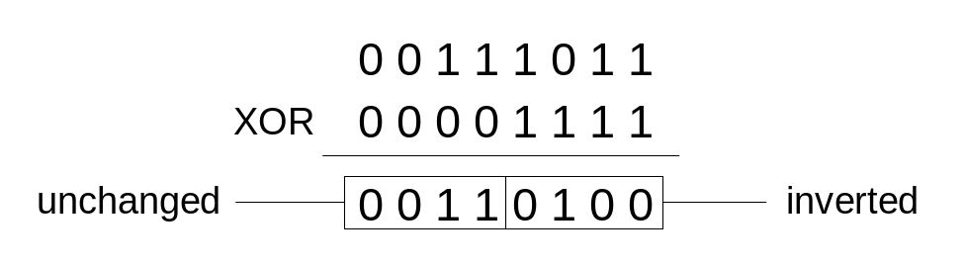

XOR Instruction
Performs a Boolean exclusive-OR operation between each pair of matching bits in two operands
XOR
XOR is a useful way to toggle (invert) the bits in an operand.

Slide 6
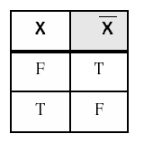
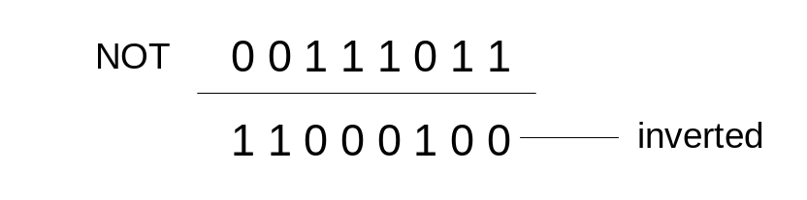
NOT Instruction
Performs a Boolean NOT operation on a single destination operand
NOT

Slide 7
Logic instruction
AND destination, source
OR destination, source
XOR destination, source
The result of the operation is stored in the Destination n, which must be a general register or a memory location. The Source may be an constant value, register, or memory location. The Destination and Source CANNOT both be memory locations.

Slide 8
Logic instruction
Instruction:
AND AH, AL ; --> means: AH = AH AND AL
AH = 01001100
AL = 00101101
------------- AND
result = 00001100 (= 12) is stored in AH

Slide 9
Logic instruction
Instruction:
OR AH, AL ; --> means: AH = AH OR AL
AH = 01001100
AL = 00101101
------------- OR
result = 01101101 (= 6Dh) is stored in AH

Slide 10
Logic instruction
Instruction:
XOR AH, AL ; --> means: AH = AH XOR AL
AH = 01001100
AL = 00101101
------------- OR
result = 01100001 (= 61h) is stored in AH

Slide 11
AND, OR, XOR
Effects on Status Flag
Zero flag (ZF), Sign flag (SF), Parity flag (PF) are affected
carry flag (CF) and overflow flag (OF) are cleared.
AF is undefined

Slide 12
AND, OR, XOR
The main usage of bitwise logical instructions is:
to set some selected bits in the Destination operand.
to clear some selected bits in the Destination operand.
to invert some selected bits in the Destination operand.
To do this, a Source bit pattern known as a mask is constructed.

Slide 13
AND, OR, XOR
The mask bits are chosen so that the selected bits are modified in the desired manner when an instruction of the form:
LOGIC_INSTRUCTION Destination , Mask
is executed. The Mask bits are chosen based on the following properties of AND, OR, and XOR: If b represents a bit (either 0 or 1) then:
b AND 1 = b b OR 1 = 1 b XOR 1 = b
b AND 0 = 0 b OR 0 = b b XOR 0 = b
AND OR XOR

Slide 14
AND, OR, XOR
The AND instruction can be used to CLEAR specific Destination bits while preserving the others. A zero mask bit clears the corresponding Destination bit; a one mask bit preserves the corresponding destination bit.

Slide 15
AND, OR, XOR
The OR instruction can be used to SET specific destination bits while preserving the others. A one mask bit sets the corresponding destination bit; a zero mask bit preserves the corresponding destination bit.

Slide 16
AND, OR, XOR
The XOR instruction can be used to INVERT specific Destination bits while preserving the others. A one mask bit inverts the corresponding Destination bit; a zero mask bit preserves the corresponding Destination bit.

Slide 17
AND, OR, XOR / Examples
Clear the sign bit of AL while leaving the other bits un changed.
AND AL, 7Fh ;the mask = 01111111b
Set the most significant and least significant bits of AL while preserving the other bits.
OR AL, 81h ;the mask = 10000001b
Change the sign bit of DX.
XOR DX, 8000h

Slide 18
Converting an ASCII Digit to a Number
For any ASCII digits, bit 4 and 5 of its ASCII code are 11; but for the corresponding decimal digit bit 4 and 5 are 00. The remaining bits are similar:
5d = 00000101, ASCII 5 = 00110101
If the key ‘5’ is pressed, AL gets 35h, to get 5 in AL, we could do:
  SUB AL, 30h
  Or
  AND AL, 0Fh

Slide 19
Changing a letter to its opposite case
The ASCII code of ‘a' to ‘z’ range from 61h to 7Ah; the code of ‘A’ to ‘Z’ go from 41h to 5Ah. If DL contain the code of a lower case letter, it can be converted to upper case by:
SUB DL,20h

Slide 20
Changing a letter to its opposite case
For any alphabetic letter, bit 5 of its ASCII code is 1; but for the corresponding uppercase letter bit 5 is 0. The remaining bits are similar:
Character code character code
A 01000001 a 01100001
B 01000010 b 01100010
. ..... ...... ....... . .
Z 01011010 z 01111010
To convert lower to upper case we can do this:
AND DL, 0DFh

Slide 21
Clearing a register
A register operand can be cleared to zero using any of the instructions: MOV, SUB, AND, and XOR. The followings are ways to clear any general-purpose register to zero.
MOV AX, 0 ;3 bytes
SUB AX, AX ;2 bytes
AND AX, 0 ;2 bytes
XOR AX, AX ;2 bytes

Slide 22
Clearing a memory location
A memory operand can be cleared to zero using either the MOV or AND instruction. The followings are ways to clear any memory location to zero.
MOV VAR1, 0
AND VAR1, 0

Slide 23
Testing a register for Zero
CMP AX,0
OR instruction can be used to examine whether or not any general-purpose register is equal to zero.
OR AX, AX
ZF is affected and if AX contains 0; ZF=1

Slide 24
NOT Instruction
Performs the one’s compliment operation in the destination:
NOT destination
No effects on the status flags
Example: complement the bits in AX
NOT AX

Slide 25
TEST Instruction
Performs an AND operation but does not change the destination contents:
TEST destination, source
Effects on Status Flag
ZF, SF, PF reflects the result
CF and OF are cleared.
AF is undefined

Slide 26
TEST Instruction
The TEST Instructions can be used to examine the status of selected bits in the destination operand.
The mask should contain 1’s in the bit positions to be tested and 0’s elsewhere.
The result will have 1’s in the tested bit positions if the destination has 1’s in these positions

Slide 27
TEST Instruction
Example
Jump to label BELOW if AL contains even number
Solution:
Bit #0 in even numbers is 0 mask = 00000001b=1
TEST AL,1
JZ BELOW

Slide 28
Shift Instruction
Shifting: The bits are shifted left or right. bits shifted out are lost.
Rotating: The bits shift out of one end of the data are placed at the other end of the data so nothing is lost.

Slide 29
Shift Instruction
Two possible formats:
;for a single shift or rotat
Opcode destination,1
;for a shift or rotat of N positions
Opcode destination,CL
where CL contains N
Destination is an 8-bit or 16-bit register or memory location

Slide 30

Shift Left Instruction
To shift 1 bit to the left we use:
  SHL dest,1
  the msb (most significant bit) is moved into CF (so the previous content of CF is lost) each bit is shifted one position to the left
  the lsb (least significant bit) is filled with 0
  dest can be either byte, word

Slide 31
Left shift instruction
Shifting multiple times to the left:
SHL dest,CL ; value in CL = number of shifts
Effect on flags:
SF, PF, ZF reflect the result
CF contains the last bit shifted from the destination
OF = 1 if the last shift changes the sign bit
AF is undefined

Slide 32
Example
Suppose DH = 8Ah, CL= 3. What are the contents of DH and of CF after execution of:
SHL DH,CL
DH= 10001010, after 3 left shift:
DH= 01010000 =50h, CF=0

Slide 33
Multiplication by left shift
Each left shift multiplies by 2 the operand for both signed and unsigned interpretations:
AL contains 5= 00000101b.
SHL AL,1 ;AL=00001010b =10d
SHL AL,1 ;AL=00010100b =20d
AX contains FFFFh (-1), CL =3
SHL AX,CL ;AX=FFF8h (-8)

Slide 34
SAL instruction
SHL is used to multiply an operand by multiples of 2.
Shift Arithmetic Left SAL is used to emphasize the arithmetic nature of the operation.
SHL and SAL generate the same machine code

Slide 35
overflow
CF and OF accurately indicate unsigned and signed overflow for a single shift.
For a multiple left shift CF, OF only reflect the result of the last shift.
BL contains 80h, CL contains 2
SHL BL,CL ;CF =OF =0, even though both signed and unsigned overflow occur

Slide 36
example
Write some code to multiply the value of AX by 8. Assume that over flow will not occur.
Solution:
MOV CL,3 ;number of shifts to do
SAL AX,CL ;multiply by 8

Slide 37

Right shift instruction
To shift to the right use:
  SHR dest, 1
  SHR dest, CL ;value of CL = number of shifts.
  The effect on the flags is the same as for SHL.

Slide 38
Example
Suppose DH = 8Ah, CL= 2. What are the contents of DH and of CF after execution of:
SHR DH,CL
DH= 10001010, after 2 right shifts:
DH= 00100010 =22h, CF=1

Slide 39

The SAR instruction
The shift arithmetic right operates like SHR, with one difference. The MSB retains its original value.
SAR des,1
SAR des, CL
The effect on flags is the same as SHR.

Slide 40
Division by right shift
A right shift might divide the destination by 2, this is correct for even numbers. For odd numbers, a right shift halves it and rounds down to the nearest integer.
Ex: if BL = 00000101b =5d
After SHR BL,1
BL = 00000010=2d

Slide 41
Signed and unsigned division
If an unsigned interpretation is being given, SHR should be used.
If a signed interpretation is being given, SAR should be used, because it preserve the sign.

Slide 42
example
Use right shifts to divide the unsigned number 65143 by 4. put the quotient in AX.
Solution:
MOV AX, 65143
MOV CL, 2
SHR AX, CL

Slide 43
example
If AL contains -15, give the decimal value of AL after SAR AL,1 is performed.
Solution:
-15d= 11110001b
After shifting :
11111000b=-8d

Slide 44

Rotate left
Shifts bits to the left. The MSB is shifted into the rightmost bit. The CF gets the bit shifted out of the MSB.
ROL des,1
ROL des, CL

Slide 45

Rotate right
Shifts bits to the right. The Right Most Bit is shifted into the MSB bit. The CF gets the bit shifted out of the RMB.
ROR des,1
ROR des, CL
We can use ROL and ROR to inspect the bits in a byte or word, without changing the contents.

Slide 46
example
Use ROL to count the number of 1 bits in BX, without changing BX. Put the answer in AX.
Solution:
XOR AX,AX JNC next
MOV CX,16 INC AX
top: next:
ROL BX, 1 LOOP top

Slide 47
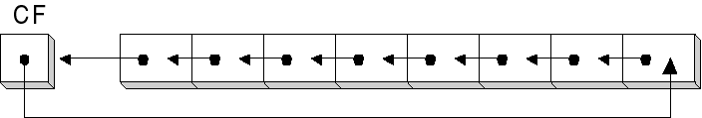
Rotate carry left
Shifts the bits of the destination to the left.
The MSB is shifted into CF, and the previous value of CF is shifted into the rightmost bit.
RCL des,1
RCL des,CL

Slide 48
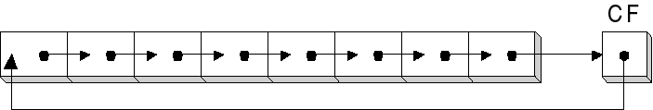
Rotate carry right
Shifts the bits of the destination to the right.
The Right Most Bit is shifted into CF, and the previous value of CF is shifted into the MSB bit.
RCR des,1
RCR des, CL

Slide 49
example
Suppose DH = 8Ah, CF = 1, and CL=3
what are the values of DH and CF after
RCR DH, CL
Solution:
CF DH
initial values 1 10001010
after 1 0 11000101
after 2 1 01100010
after 3 0 10110001

Slide 50
Effect of the rotate instructions on the flags
CF = last bit shifted out
OF = 1 if result changes sign on the last rotation. (if count more then 1, OF is undefined)

Slide 51
An Application
Reversing a Bit Pattern

Slide 52
Reversing the Bit Pattern
in a word or a byte.
Example :
AL contains 11011100 we want to make it 00111011

Slide 53
Solution
SHL from AL to CF and
RCR to move them into the left end of another register… BL
1
1
0
1
1
1
0
0
0
0
1
1
1
0
1
1

Slide 54
SHL & RCR
CF
1
1
0
1
1
1
0
0
AL
1
1
0
1
1
1
0
0
0
AL
1
0
0
0
0
0
0
0
BL
0
CF

Slide 55
SHL & RCR
CF
1
1
0
1
1
1
0
0
AL
1
1
0
1
1
1
0
0
0
AL
0
0
1
1
1
0
1
1
BL
0
CF

Slide 56
Code
MOV CX,8 ; no. of operation to do
REVERSE :
SHL AL,1 ; get a bit into CF
RCR BL,1 ; rotate it into BL
LOOP REVERSE ; loop until done
MOV AL,BL ; AL gets reverse patterns

Slide 57
Binary & hex I/O
Binary input :
read in a binary number from keyboard, followed by a carriage return.
character strings of 1’s & 0’
we need to convert each character to a bit value& collects the bits in a register

Slide 58
Algorithm
Clear BX….. To hold the binary value
Input a character …….. ‘1’ or ‘0’
WHILE character <> CR then
  Convert character to binary value
  Left shift BX
  Insert value into LSB of BX
  Input a character
  END_WHILE

Slide 59
Demonstration for input
110
Clear BX
  BX 0000 0000 0000 0000
  Input a character ‘1’ convert to 1
  Left Shift BX
  BX 0000 0000 0000 0000
  Insert value into LSB
  BX 0000 0000 0000 0001

Slide 60
Demonstration for input
110
  Input a character ‘1’ convert to 1
  Left Shift BX
  BX 0000 0000 0000 0010
  Insert value into LSB
  BX 0000 0000 0000 0011

Slide 61
Demonstration for input
110
  Input a character ‘0’ convert to 0
  Left Shift BX
  BX 0000 0000 0000 0110
  Insert value into LSB
  BX 0000 0000 0000 0110
  BX contains 110b

Slide 62
The algorithm assumes
Input characters are either “0”,”1”or CR
At most 16 bit are input
BX is shifted left to make room and the OR operation is used to insert the new bit into BX

Slide 63
Code
  XOR BX,BX ; clear BX
  MOV AH,1 ; input character function
  INT 21H ; read a character
  WHILE_:
  CMP AL,0DH ; CR?
  JE END_WHILE ; yes , done
  AND AL,0FH ; no, convert to binary value
  SHL BX,1 ; make room for new value
  OR BL,AL ; put value in BX
  INT 21H ; read a character
  JMP WHILE_ ; loop back
  END_WHILE :

Slide 64
Binary & hex I/O
Binary output:
Outputting contents of BX in binary … Shift Operation

Slide 65
Algorithm
FOR 16 times DO
Rotate left BX /* BX … output
CF … MSB */
IF CF = 1
THEN
output ‘1’
ELSE
output ‘0’
END_IF
END_FOR

Slide 66
Binary output
MOV AH, 2
MOV CX, 16
TOP:
ROL BX, 1
JC DS1
MOV DL,’0’ ; OR 30H
JMP DSS
DS1:
MOV DL,’1’ ;OR 31H
DSS:
INT 21H
LOOP TOP

Slide 67
Decimal Input
.model small
.stack 100h
.data
y db 0
.code
main proc
mov ax,@data
mov ds,ax
mov ah,1
int 21h
wh_:
cmp al,0dh
je end_
call insert_digit
next:
int 21h
jmp wh_
insert_digit proc
mov cl,3
and al,0fh ; convert to decimal
mov bl,y
shl y,cl ; * 8
shl bl,1 ; *2
add y,bl
add y,al
ret
insert_digit endp
end main
end_:
mov ah,4ch
int 21h
main endp

